Slide 1
Error Detection and Correction
Dr. Nitin Rakesh

Slide 2
How Hamming Codes Work
One parity bit can tell us an error occurred
Multiple parity bits can also tell us where it occurred
O(lg(n)) bits needed to detect and correct one bit errors

Slide 3
Hamming (7, 4)
7 bits total
4 data bits
3 parity bits
Can find and correct 1 bit errors
or
Can find but not correct 2 bit errors

Slide 4
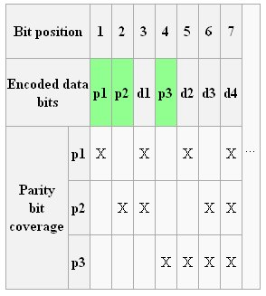
Hamming Bits Table

Slide 5
Example
Byte 1011 0001 Two data blocks, 1011 and 0001. Expand the first block to 7 bits: _ _ 1 _ 0 1 1. Bit 1 is 0, because b3+b5+b7 is even. Bit 2 is 1, b3+b6+b7 is odd. bit 4 is 0, because b5+b6+b7 is even. Our 7 bit block is: 0 1 1 0 0 1 1
Repeat for right block giving 1 1 0 1 0 0 1
0 0 0 1

Slide 6
Example
Byte 1011 0001 Two data blocks, 1011 and 0001. Expand the first block to 7 bits: _ _ 1 _ 0 1 1. Bit 1 is 0, because b3+b5+b7 is even. Bit 2 is 1, b3+b6+b7 is odd. bit 4 is 0, because b5+b6+b7 is even. Our 7 bit block is: 0 1 1 0 0 1 1
Repeat for right block giving 1 1 0 1 0 0 1

Slide 7
Example
Find Hamming bit for
i) 11011001
ii) 00010100
iii) 11111111
iv) 01011010

Slide 8
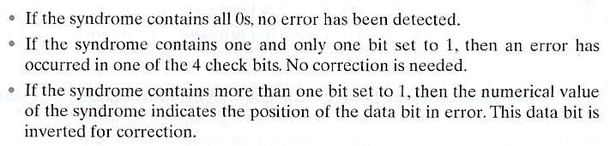
Hamming Code Syndrome Design Criteria

Slide 9
A Layout of Data and Check Bits that Achieves Our Design Criteria:
C1 is a parity check on every data bit whose position is xxx1
C1 = D1 exor D2 exor D4 exor D5 exor D7
C2 is a parity check on every data bit whose position is xx1x
C2 = D1 exor D3 exor D4 exor D6 exor D7
C4 is a parity check on every data bit whose position is x1xx
C4 = D2 exor D3 exor D4 exor D8
C8 is a parity check on every data bit whose position is 1xxx
C8 = D5 exor D6 exor D7 exor D8
Why this ordering? Because we want the syndrome, the Hamming test word, to yield the address of the error.

Slide 10
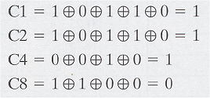
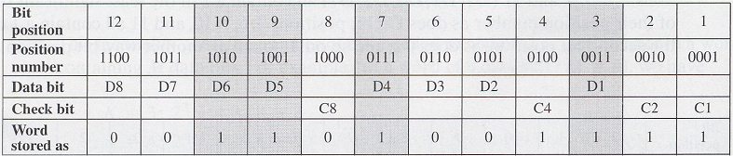
Example:
Data stored = 00111001
Check bits:
Putting it together:

Slide 11
Example:
Data stored = 00111001
Check bits:
Putting it together:

Slide 12
Example:
Data stored = 00111001
Check bits:
Putting it together:

Slide 13
Example:
Data stored = 00111001
Check bits:
Putting it together:

Slide 14
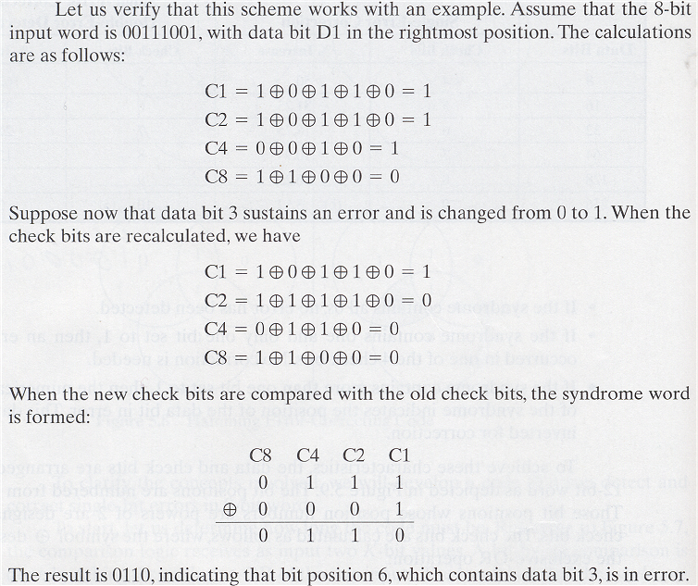
Example:

Slide 15
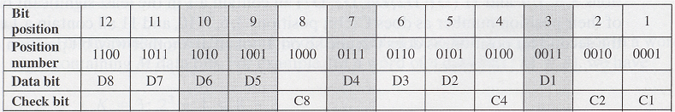
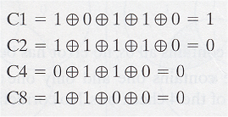
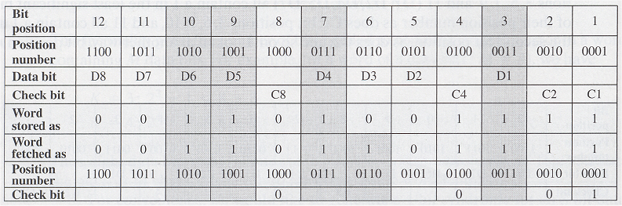
Example:
Word fetched:
Check Bits:
Comparing:
C8 C4 C2 C1
0 1 1 1 Orig Check Bits
0 0 0 1 New Check Bits
0 1 1 0 Syndrome
0110 = 6 ➔ bit position 6 is wrong, i.e. bit D3 is wrong
Putting it all together:

Slide 16
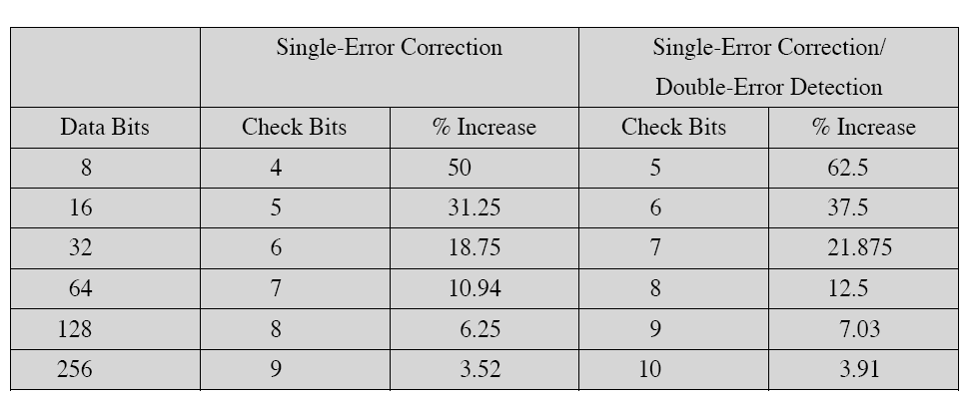
Increased word length for error correcting

Slide 17
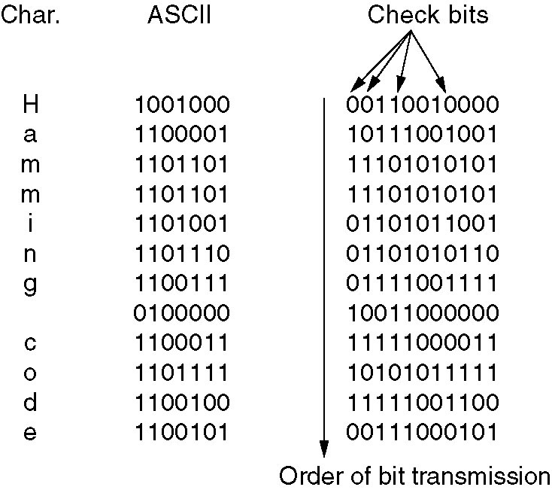
Hamming Code: Example
7-bit
. Hamming codes can only correct single errors.
. But, to correct bursts of errors, send column by column.

Slide 18
Hamming Code: Example
7-bit
. Hamming codes can only correct single errors.
. But, to correct bursts of errors, send column by column.

Slide 19
Cyclic Redundancy Check (CRC)
Mostly used in data communication
Tells us whether an error has occurred, but does not correct the error.
This is a type of “systematic error detection”
The error-checking bits are appended to the information byte

Slide 20
Cyclic Redundancy Check (CRC)
Bit strings represented as polynomials with coef. 0 and 1.
K bit frame =>x^{k-1}+…+1 (first and last coef must be 1)
Example
110001 => x⁵+x⁴+1
Polynomial arithmetic is done module 2 i.e. ⬄ addition/subtraction = XOR operation

Slide 21
Cyclic Redundancy Check (CRC)
Bit strings represented as polynomials with coef. 0 and 1.
K bit frame =>x^{k-1}+…+1 (first and last coef must be 1)
Example
110001 => x⁵+x⁴+1
Polynomial arithmetic is done module 2 i.e. ⬄ addition/subtraction = XOR operation

Slide 22
CRC
Sender (S) and Receiver (R) agree on a generator polynomial G(x)
Frame – m bits => M(X) – the checksum of m is the remaining of R(x)=M(x)/G(x)
Checksum added to frame.
(R) Gets the frame M’(x)=[M(x)-R(x)]
If M’(x)/G(x) has remainder => error

Slide 23
Modulo 2 Arithmetic
Addition Rules
0 + 0 = 0 Ex: 1011
0 + 1 = 1 +110
1 + 0 = 1 1101
1 + 1 = 0

Slide 24
Modulo 2 Arithmetic
Division
________
Ex: 1011 | 1001011
^ ^
divisor dividend

Slide 25
Modulo 2 Arithmetic
Division
____1___
Ex: 1011 | 1001011
1011

Slide 26
Modulo 2 Arithmetic
Division
____1___
Ex: 1011 | 1001011
1011
0010

Slide 27
Modulo 2 Arithmetic
Division
____10__
Ex: 1011 | 1001011
1011
00100

Slide 28
Modulo 2 Arithmetic
Division
____101_
Ex: 1011 | 1001011
1011
001001

Slide 29
Modulo 2 Arithmetic
Division
____101_
Ex: 1011 | 1001011
1011
001001
1011

Slide 30
Modulo 2 Arithmetic
Division
____101_
Ex: 1011 | 1001011
1011
001001
1011
0010

Slide 31
Modulo 2 Arithmetic
Division
____1010
Ex: 1011 | 1001011
1011
001001
1011
00101

Slide 32
Modulo 2 Arithmetic
Division
____1010 ← Quotient
Ex: 1011 | 1001011
1011
001001
1011
00101 ← Remainder

Slide 33
Calculating and Using CRCs
Let the information byte F = 1001011
The sender and receiver agree on an arbitrary binary pattern P. Let P = 1011.
Shift F to the left by 1 less than the number of bits in P. Now, F = 1001011000.
Let F be the dividend and P be the divisor. Perform “modulo 2 division”.
After performing the division, we ignore the quotient. We got 100 for the remainder, which becomes the actual CRC checksum.
Add the remainder to F, giving the message M:
1001011 + 100 = 1001011100 = M

Slide 34
Calculating and Using CRCs
M is decoded and checked by the message receiver using the reverse process.
____1010100
1011 | 1001011100
1011
001001
1001
0010
001011
1011
0000 ← Remainder

Slide 35
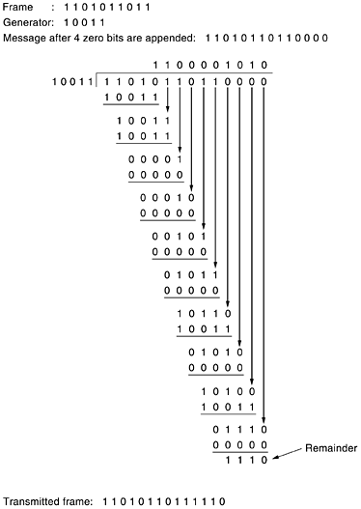
CRC – Example, Transmitted Frame

Slide 36
CRC - Example
Frame – 1101011011
G(x)=x⁴+x+1
Transmitted frame:
11010110110000 –
00000000001110
----------------------
11010110111110

Slide 37
Reed-Solomon (RS)
Operates at block level instead of bit level
- RS(n, k) codes are defined using the following parameters
s = the number of bits in a char (8 bits)
k = the number of s-bit characters comprising the data block
n = the number of bits in the code word
RS(n, k) can correct (n – k)/2 errors in the k information bytes
EX: RS(255, 223)
can correct up to 16 erroneous bytes in the information block

Slide 38
Summary
3 Types of Error Detection/Correction Methods
Cyclic Redundancy Check (CRC)
Used primarily in communication
Can only detect errors.
Hamming Codes
Can detect and correct errors.
The more parity bits added, the more errors can be detected and corrected.
Used to detect errors in memory bits or fixed magnetic disk drives, in which errors occur randomly.

Slide 39
Summary
Reed-Solomon (RS)
Can detect errors that occur in blocks (adjacent errors)
Used to detect errors in removable media such as magnetic tapes or compact disks, in which “burst errors” occur due to mishandling and environmental stress.
Ch 2.7 > Summary

Slide 40
Flow + Error Control
How do Layer 2 protocols implement them?
What’s a frame?
F
H
Payload
T
F
. What’s F?
. What’s in T?
. What’s in H?

Slide 41
Header and Trailer
Trailer typically has checksum.
How is it used/processed?
Header has: type, sequence number, and ack.

Slide 42
Stop-and-Wait
Simplest form of flow control.
How does it work? (assume error-free channel)
(1) Send 1 frame;
(2) Wait for ACK.
(3) Go to 1.

Slide 43
Stop-and-Wait: Pros and Cons
Very simple!
But, poor link utilization.
High data rates.
Long propagation delay.

Slide 44
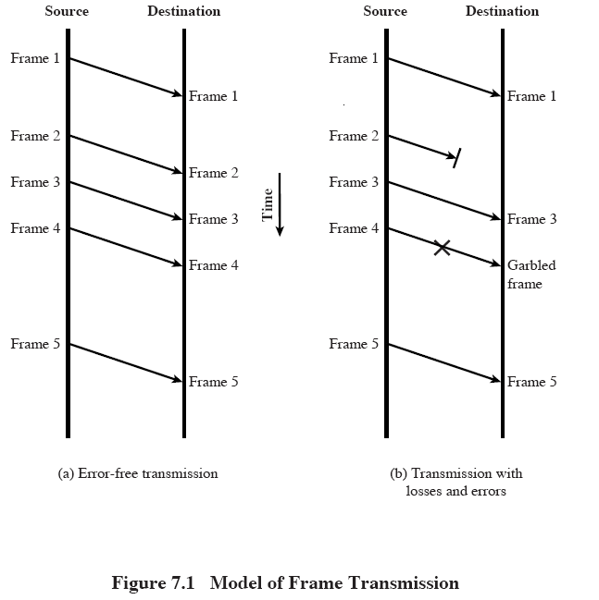
Noisy Channels

Slide 45
Stop-and-Wait in Noisy Channels
Need timers, retransmissions, and duplicate detection.
Use sequence numbers.
Why?
Distinguish frames.
How large (e.g., in number of bits) are sequence numbers?

Slide 46
ARQ Protocols
Automatic Repeat reQuest.
Protocols that wait for ACK before sending more data.
ACKs now are used for flow AND error control.
What can happen?
At receiver: frame arrives correctly, frame arrives damaged, or frame does not arrive.
At sender: ACK arrives correctly, ACK arrives damaged, or ACK does not arrive.

Slide 47
ARQ Protocols
Sender:
Send frame 0.
Start timer.
If ACK 0, arrives, send frame 1.
If timeout, re-send frame 0.
Receiver:
**Waits for frame.
If frame arrives, check if correct sequence number.
Then send ACK for that frame.
Go to (**)

Slide 48
Simplex versus Duplex Transmission
Simplex:
Send data in one channel and control in another channel.
Duplex:
Send data and control on the same chanel.

Slide 49
Can we do better?
Can we do better?
Piggybacking.
Bi-directional transmission.
Wait for data packet and use that to piggyback the ACK.
Use ACK field: only a few additional bits in the header.
But, how long should Layer 2 wait to send an ACK?
ACK timers!

Slide 50
Sliding Window Protocols
Window: number of “outstanding” frames at any given point in time.
So what’s the window size of Stop and Wait?
Every ACK received, window slides.

Slide 51
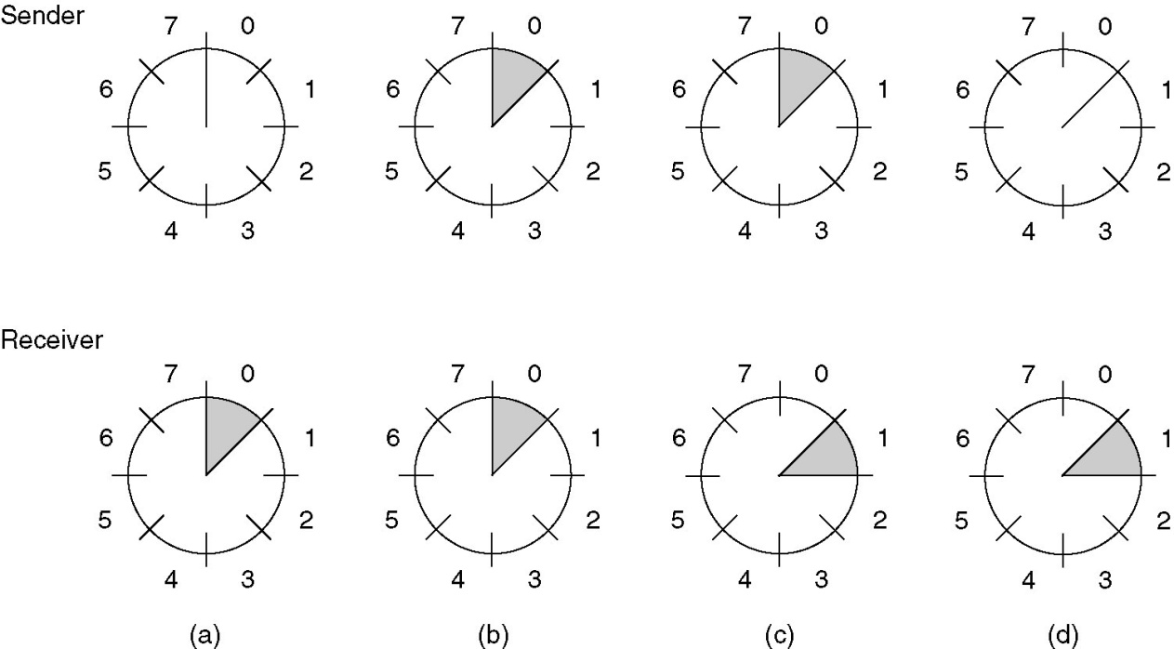
Sliding Window: Example
A sliding window of size 1, with a 3-bit sequence number.(a) Initially; (b) After the first frame has been sent; (c) After the first frame has been received;(d) After the first acknowledgement has been received.

Slide 52
Sliding Window: Basics
Allows multiple frames to be in transit at the same time.
Receiver allocates buffer space for n frames.
Transmitter is allowed to send n (window size) frames without receiving ACK.
Frame sequence number: labels frames.

Slide 53
Sliding Window: Receiver
Receiver ack’s frame by including sequence number of next expected frame.
Cumulative ACK: ack’s multiple frames.
Example: if receiver receives frames 2,3, and 4, it sends an ACK with sequence number 5, which ack’s receipt of 2, 3, and 4.

Slide 54
More Sliding Window …
Sender maintains sequence numbers it’s allowed to send; receiver maintains sequence number it can receive.
Sequence numbers are bounded; if frame reserves k-bit field for sequence numbers, then they can range from 0 … 2^{k} -1^{k}.
Transmission window shrinks each time frame is sent, and grows each time an ACK is received.

Slide 55
Example: 3-bit sequence number and window size 7
A (Sender) B (Receiver)
0 1 2 3 4 5 6 7 0 1 2 3 4… 0 1 2 3 4 5 6 7 0 1 2 3 4
0
1
2
0 1 2 3 4 5 6 7 0 1 2 3 4
0 1 2 3 4 5 6 7 0 1 2 3 4
ACK 3
0 1 2 3 4 5 6 7 0 1 2 3 4
0 1 2 3 4 5 6 7 0 1 2 3 4
3
4
5
6
0 1 2 3 4 5 6 7 0 1 2 3 4
ACK 4
0 1 2 3 4 5 6 7 0 1 2 3 4
0 1 2 3 4 5 6 7 0 1 2 3 4
0 1 2 3 4 5 6 7 0 1 2 3 4

Slide 56
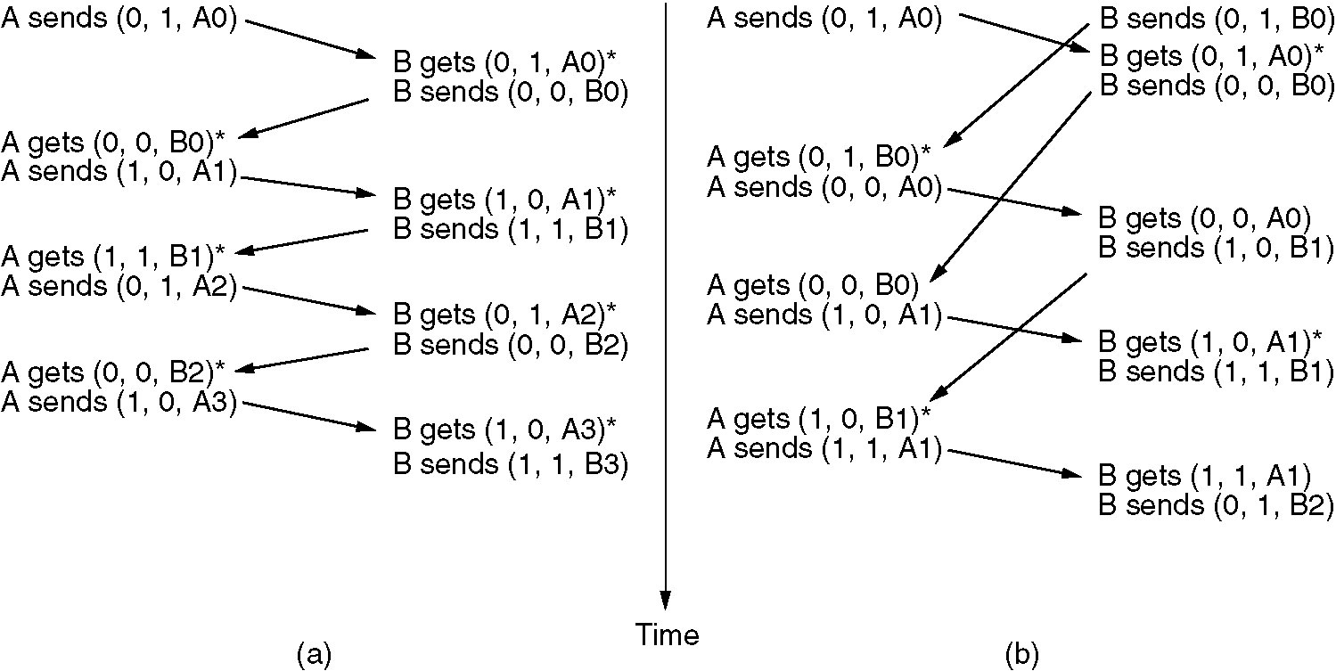
One-Bit Sliding Window Protocol
Two scenarios: (a) Normal case. (b) Abnormal case. Notation is (seq, ack, packet number). An * indicates where a network layer accepts packet. ACK indicates last sequence number received.

Slide 57
Bandwidth-Delay Product
How large should the sender’s window be?
Function of how “fat” is the pipe?
BW
S
R
RTT
W = BW*RTT/data size

Slide 58
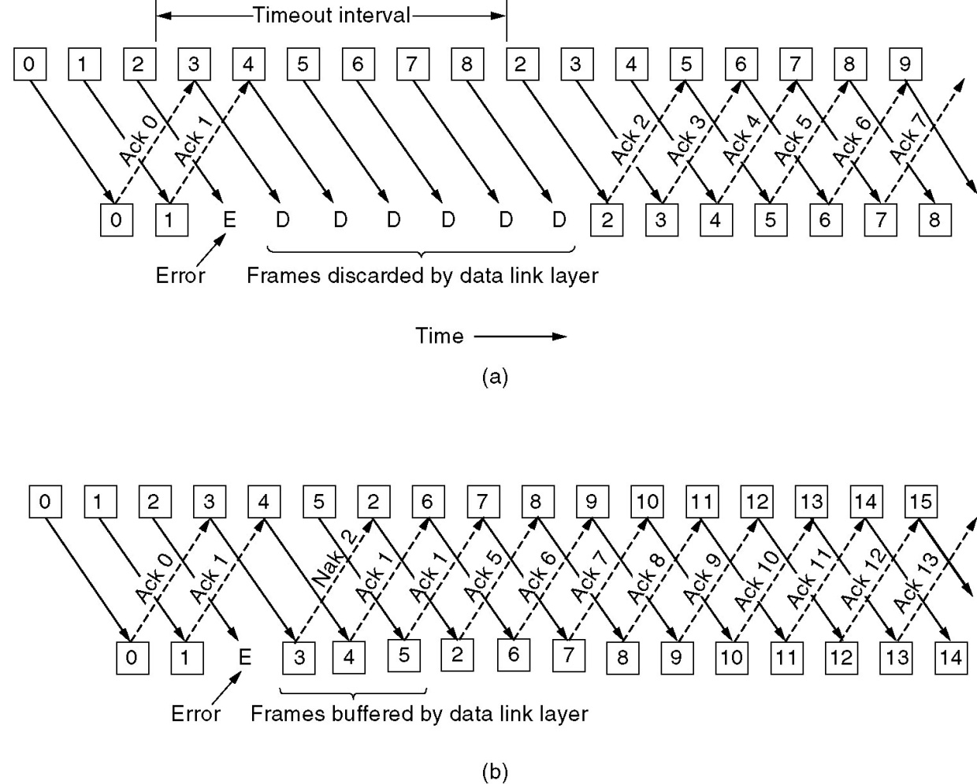
Pipelining
Receiver’s
window size
is 1: discard
frames after error
with no ACK.
Go Back N
Receiver’s
window size
is large: buffers
all frames until error
recovered.
Selective Repeat
Pipelining and error recovery. Effect on error when (a) Receiver’s window size is 1. (b) Receiver’s window size is large.

